Slide 1

IMAGE SCRAPING AND
CLASSIFICATION
SUBMITTED BY : NARA LOHITH

Slide 2

Conceptual Background of the Domain Problem
 Images are one of the major sources of data in the
field of data science and AI. This field is making
appropriate use of information that can be gathered
through images by examining its features and details.
 The idea behind this project is to build a deep
learning-based Image Classification model on images
that will be scraped from e-commerce portal. This is
done to make the model more and more robust.

Slide 3
Problem Statement
 We have to scrape images from e-commerce portal,
Amazon.com. The clothing categories used for
scraping will be:
 Sarees (women)
 Trousers (men)
 Jeans (men)
 After the data collection and preparation is done, you
need to build an image classification model that will
classify between these 3 categories mentioned above.

Slide 4
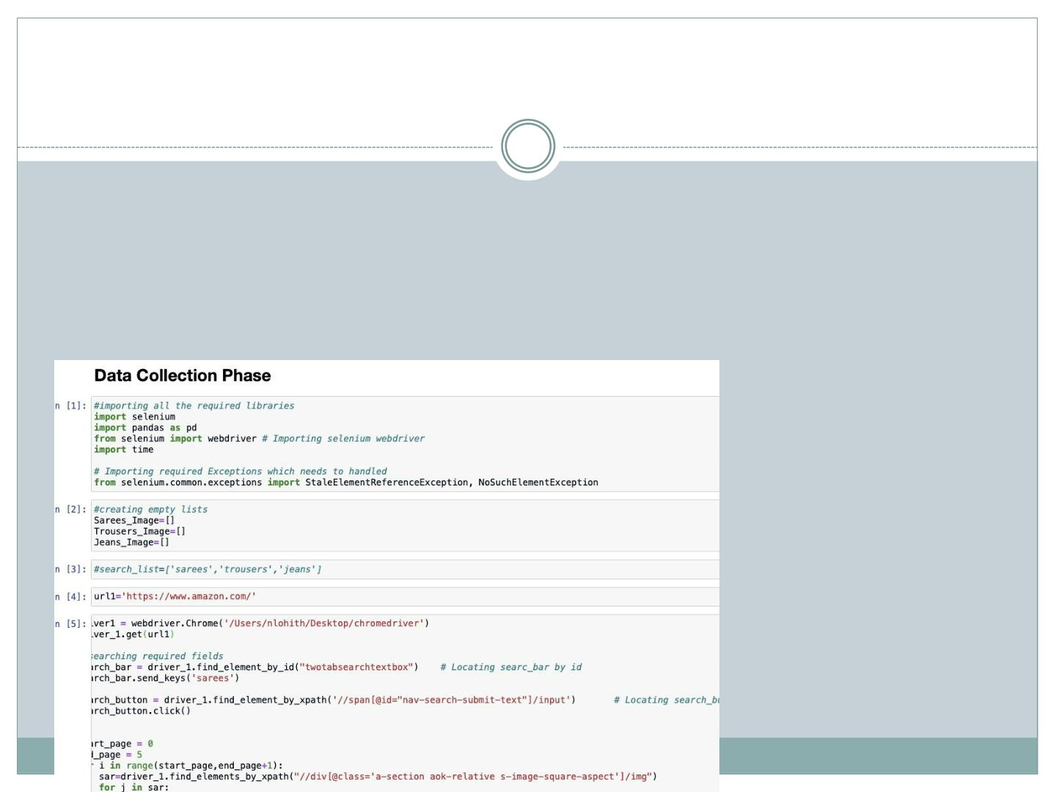
Analytical Problem Framing
 Data Collection Phase:
 We have collected/scraped data from amazon for the
three categories: Sarees, Jeans and Trousers.
 In total there are 343 rows for each of the items as
shown below:

Slide 5
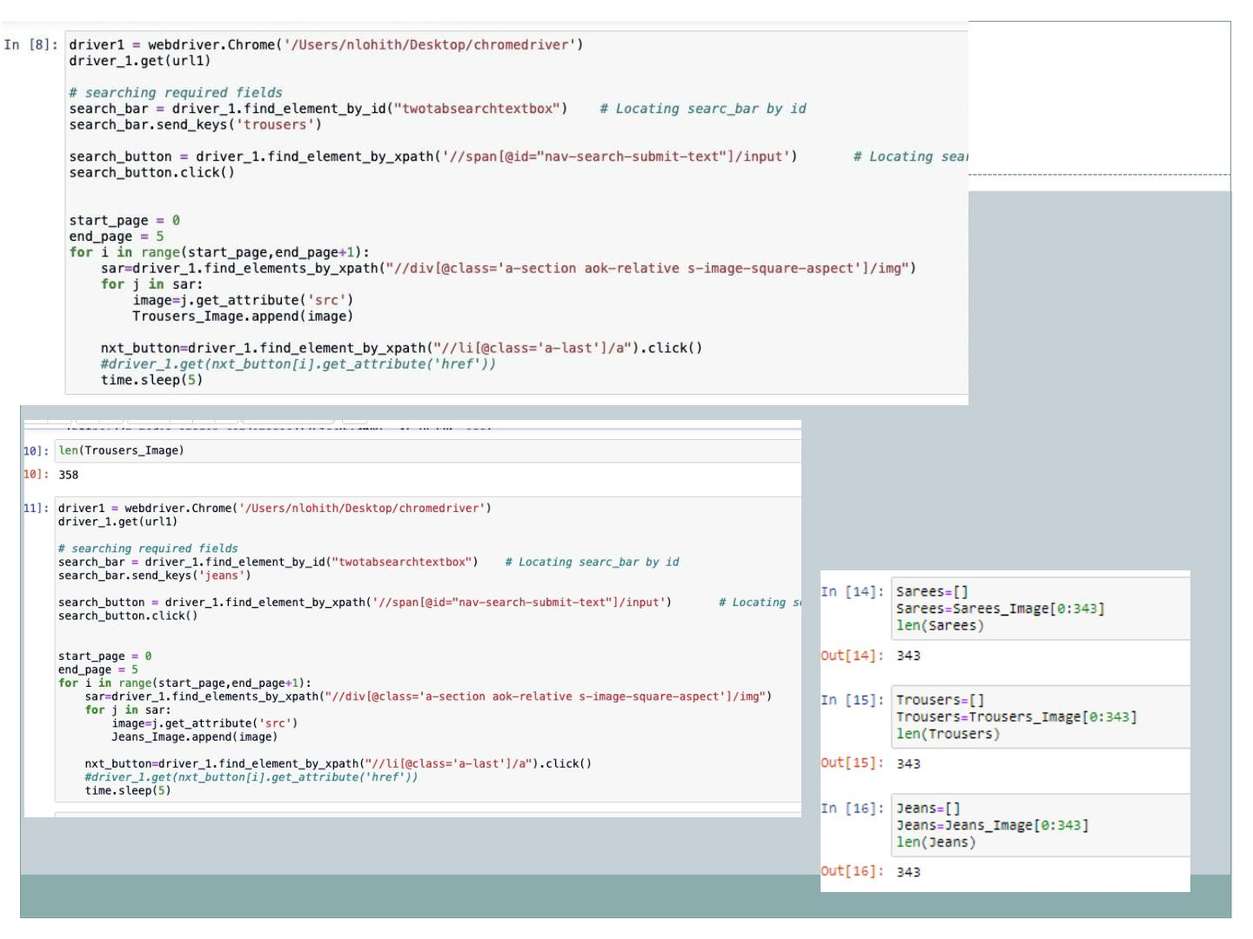

Slide 6
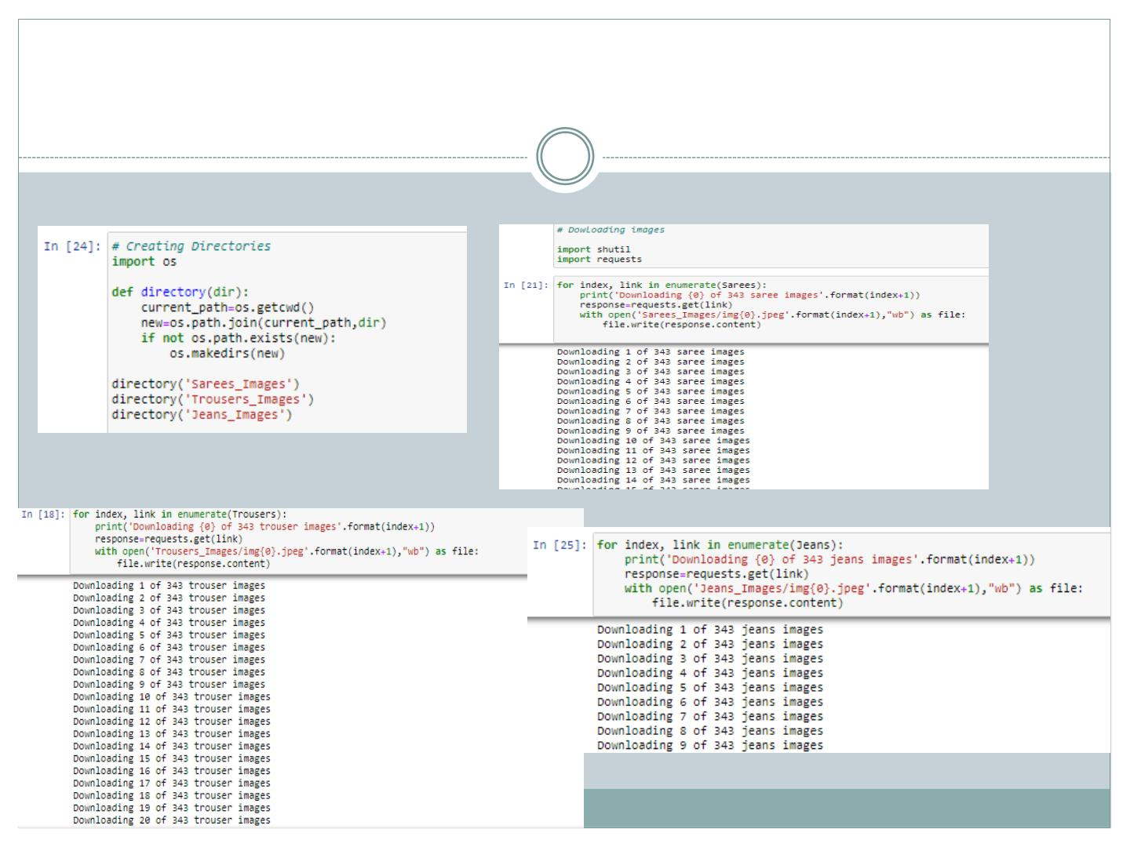
 Next we created directories to store images of each
clothing item scraped above. Further we will be
downloading images to required folders/directories
along with download status message.

Slide 7
Model/s Development and Evaluation
 After collecting the data we next do training of the
data. For that firstly, we created a main folder called
“Clothes” in current working directory inside which I
further created two folders called “Train” and “Test”.
 In Train folder we have kept 300 images from each
clothing category and remaining 43 images we have
kept in Test folder for each category. Hence, we got
900 images for training and 129 for testing.

Slide 8
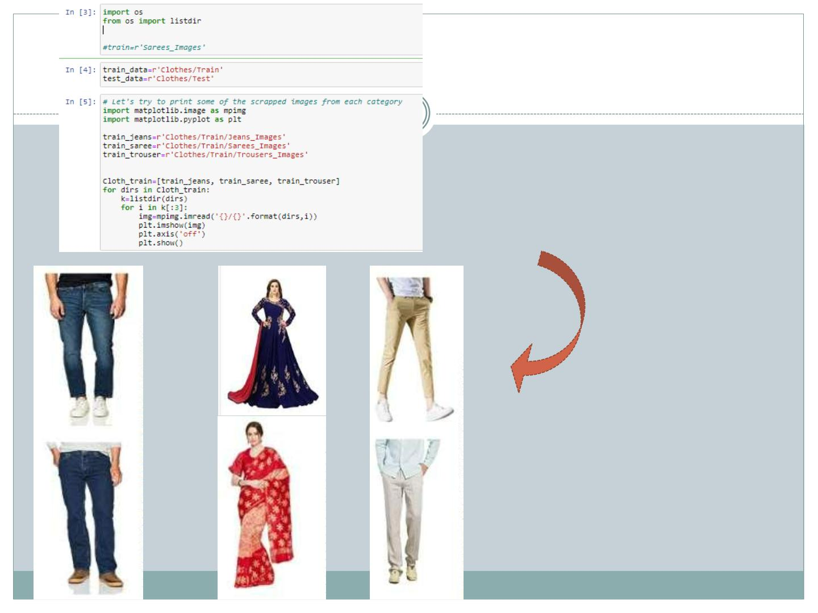
printing some of the scrapped images
from each category

Slide 9
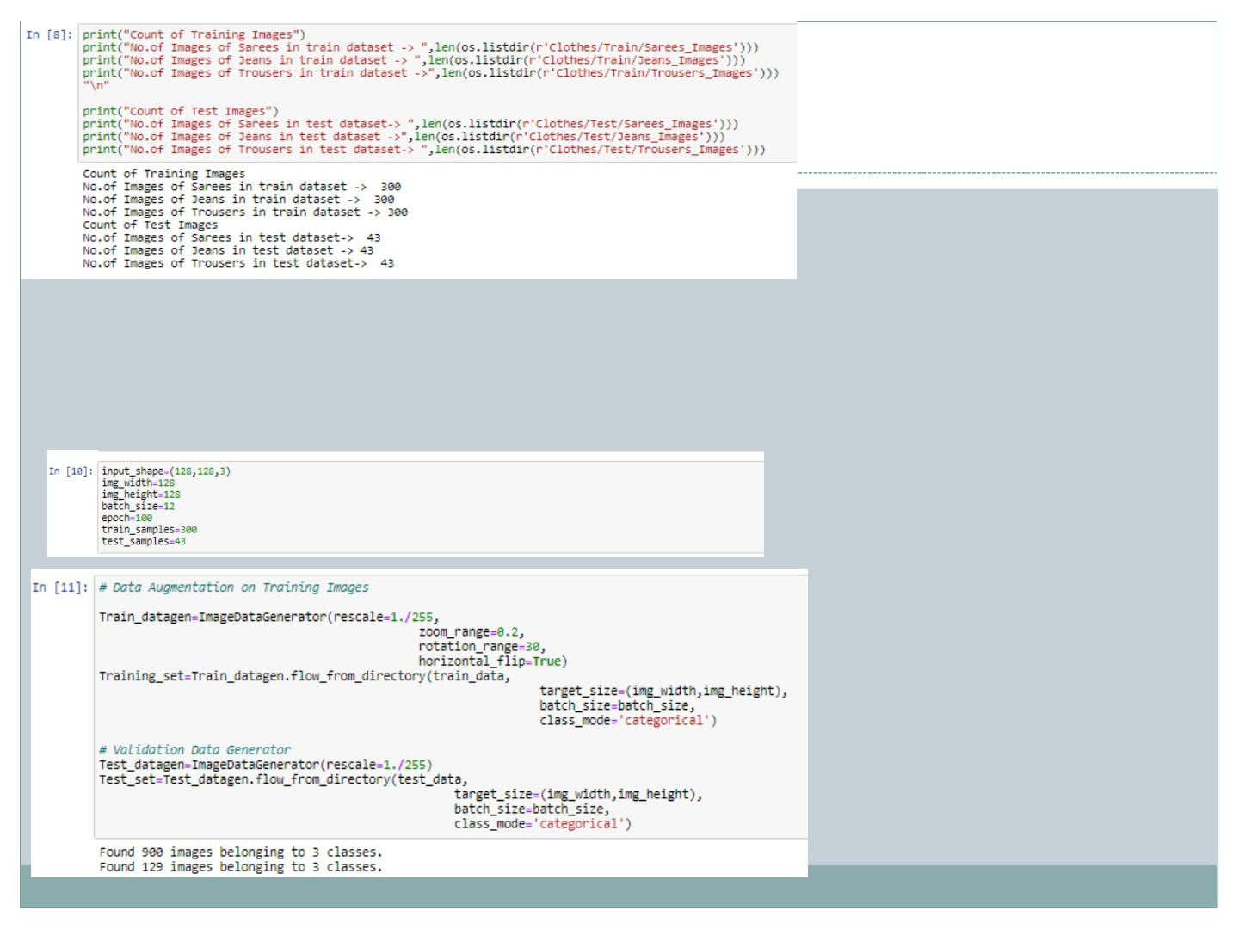
 Next we defined dimensions of images and other
parametrs also. Then, for data augmentation we
defined training and testing set.

Slide 10
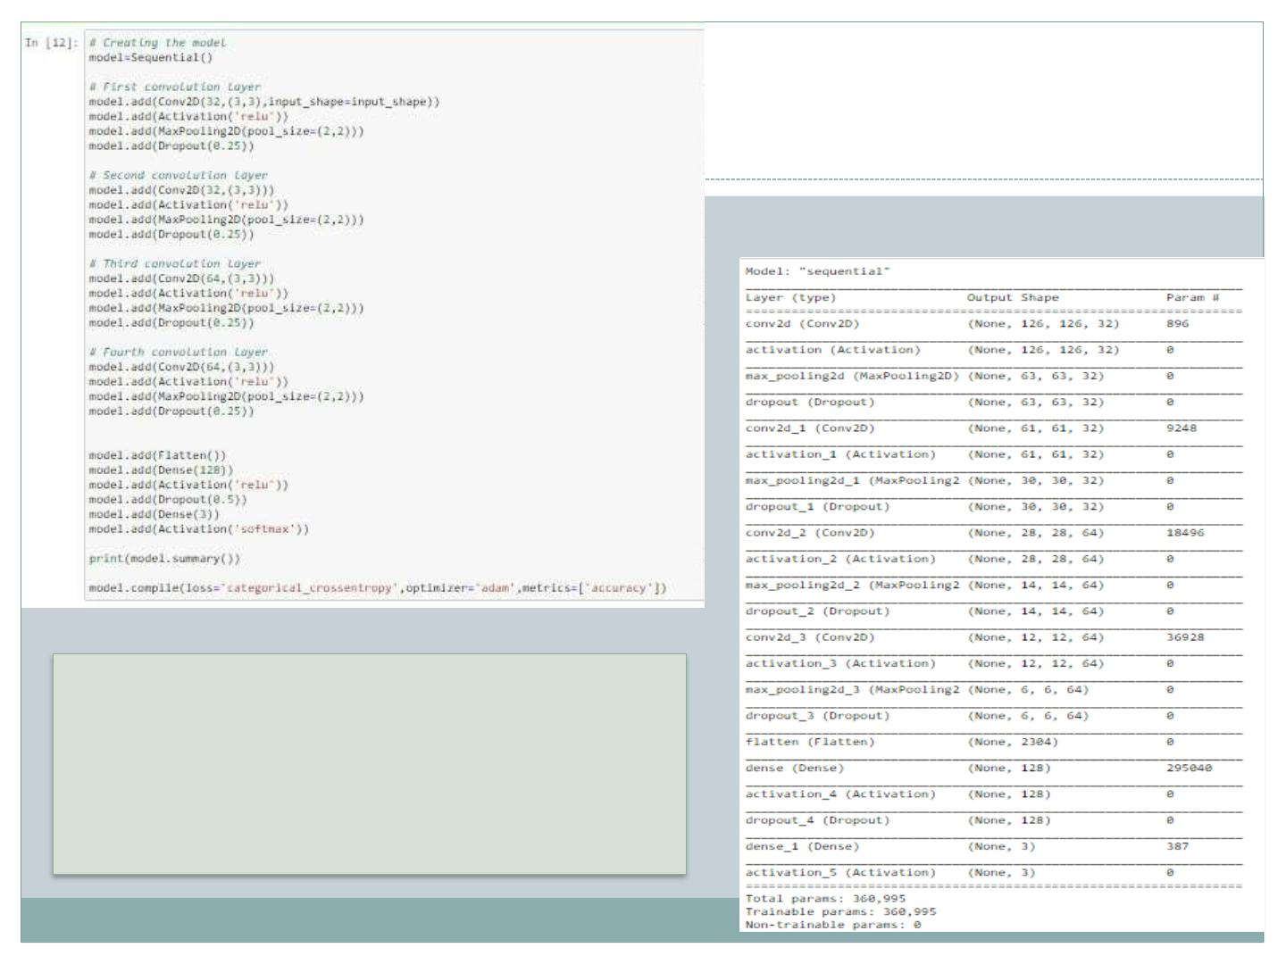
Model Architecture for
forward & back
propagation

Slide 11
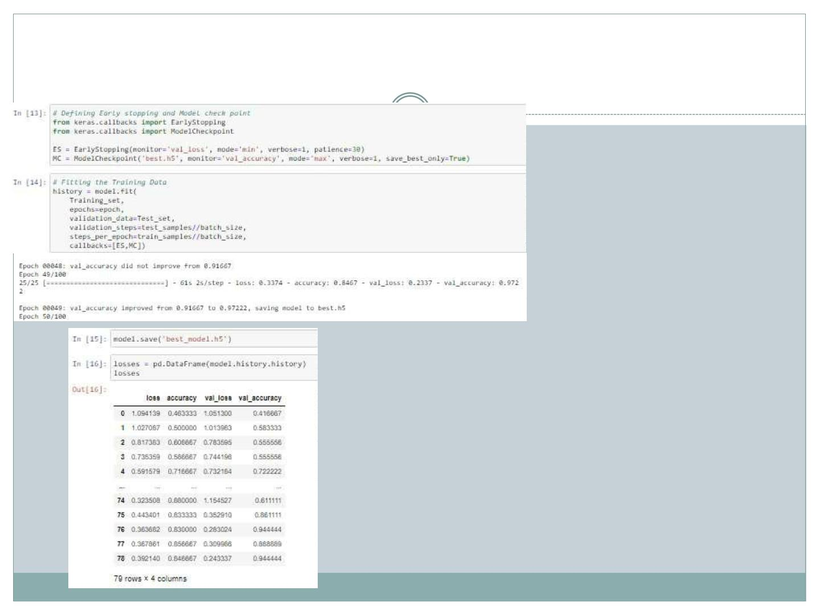
 Then we defined Early Stop criteria and saved the
model as ‘best.h5’ for the best results.

Slide 12
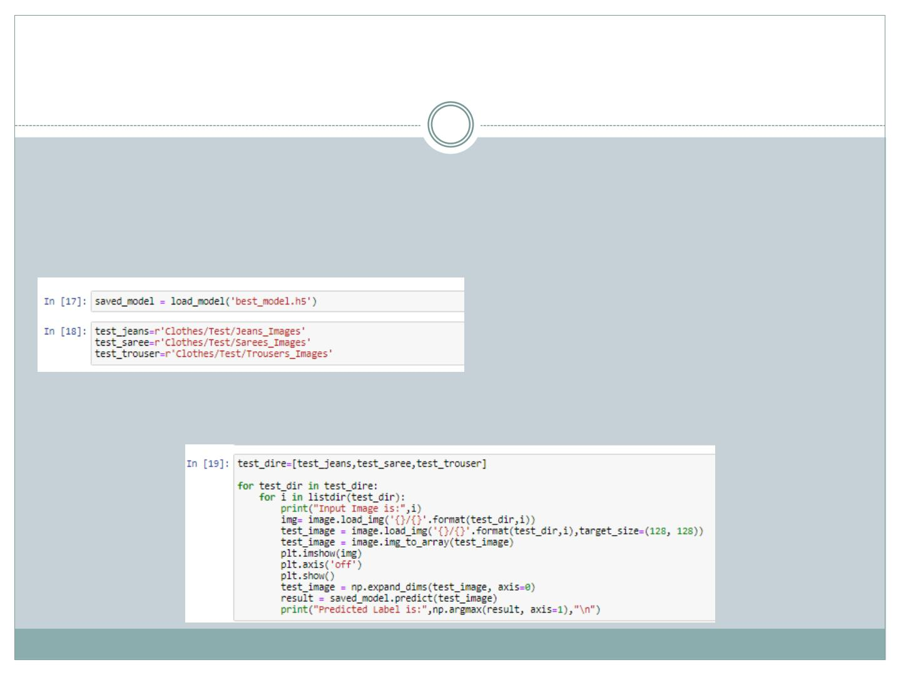
Prediction
 Now, we load our saved model and do prediction of
our test images.
 For that we first load all the test images from test
folder created in main folder Clothes as follows:
 Then we predicted the images and displayed it as
shown:

Slide 13
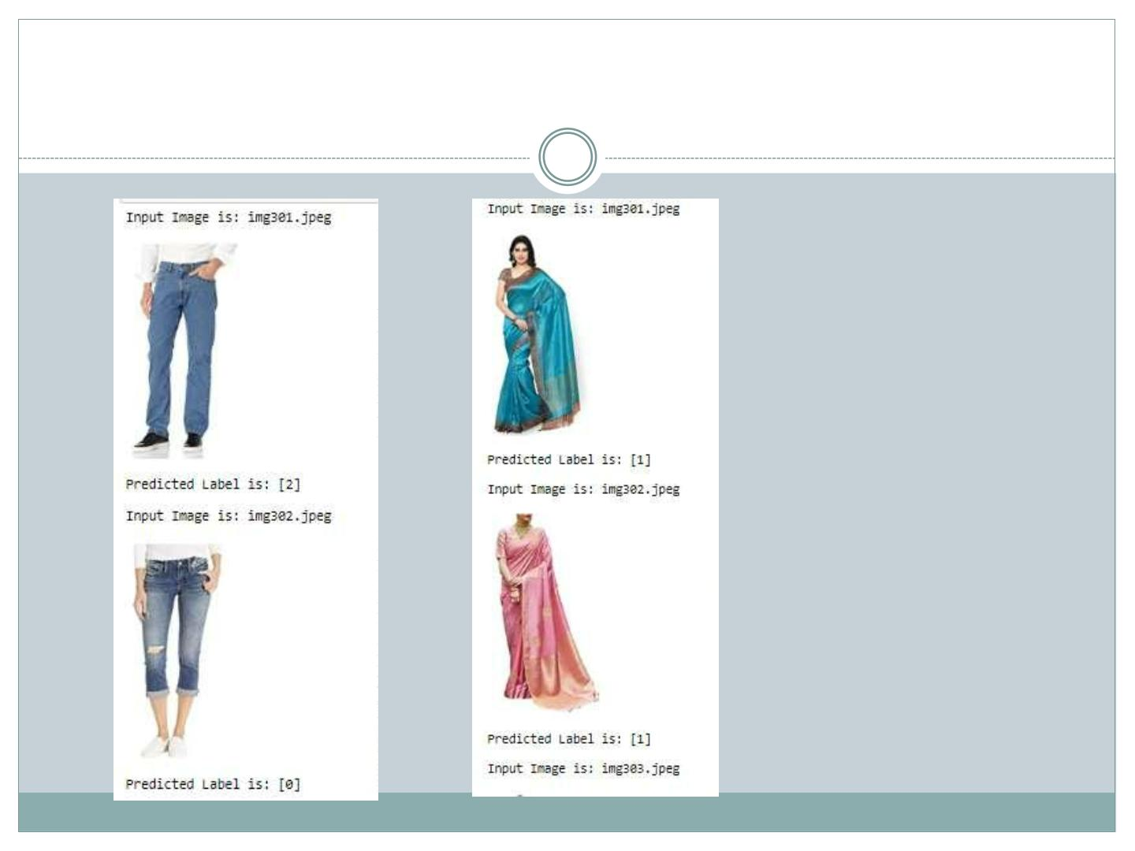
 Predicted Images:

Slide 14
CONCLUSION
 Our model is working well and gave accuracy of 97%.
 It was able to classify the three clothing items
distinctly.
 Since in all three categories there were some
extra/unnecessary items other than the main items
hence, it could have been removed and we could
have got better result. Moreover, training data could
have been increased.

